Slide 1
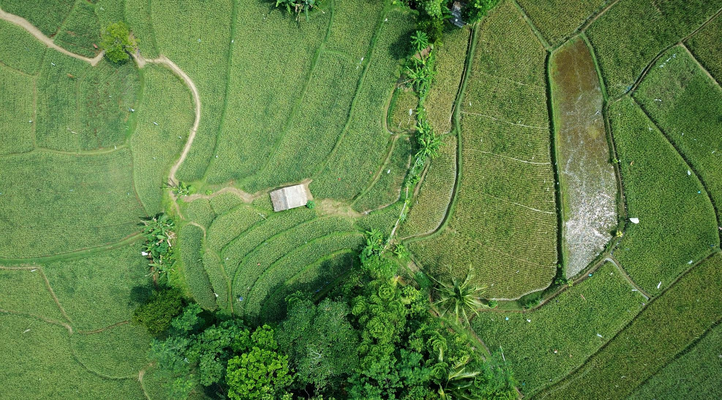

Implementation and Comparison of Water Based Indices on Sentinel 2A images
Chintan Maniyar • Srishti Pandey • Anushree Jain • Ravi Kant • Vishnu Bajpai

Slide 2
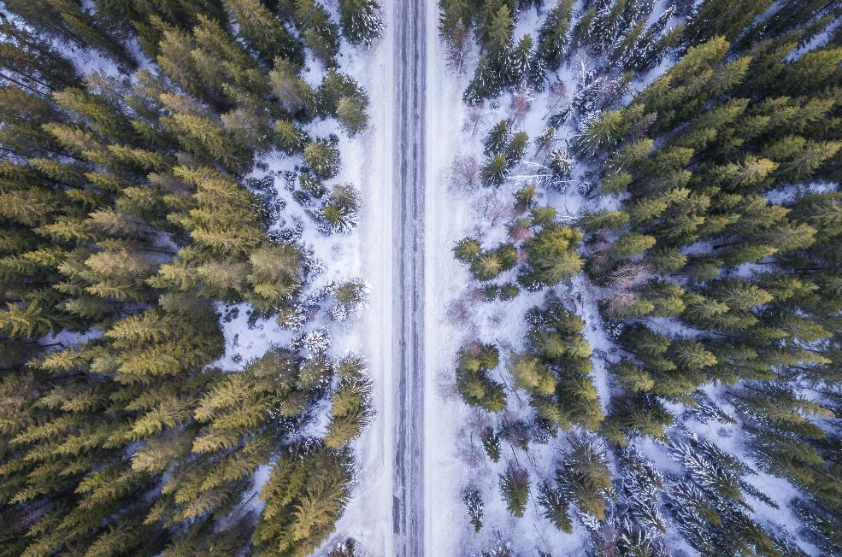

Overall Objective
Sub Objectives:
To understand and conclude the behavior of each index implemented by interpreting resultant images
Exploring temporal optical datasets related to the study
Exploring various open source tools and libraries available in Python for remote sensing
Compare the nature of water bodies and their surrounding areas using various water quality indices

Slide 3


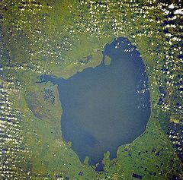
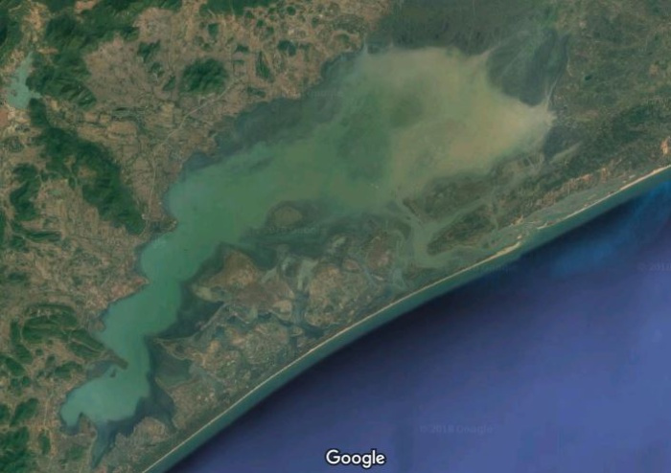

Study Sites
Dataset Used:
Sentinel 2, Level 2A Images
ESA DHUS API
Chilikha Lake: Dec 24, 2018
Okeechobee Lake: Dec 22, 2018
Okeechobee Lake
Chilikha Lake
Chilikha Lake, Orissa, India
Okeechobee Lake, Florida, US

Slide 4





The Global Problem of Water Quality
Changing Climate
Water Shortages
Longer Winters
Algal Bloom
Industrial Impact

Slide 5
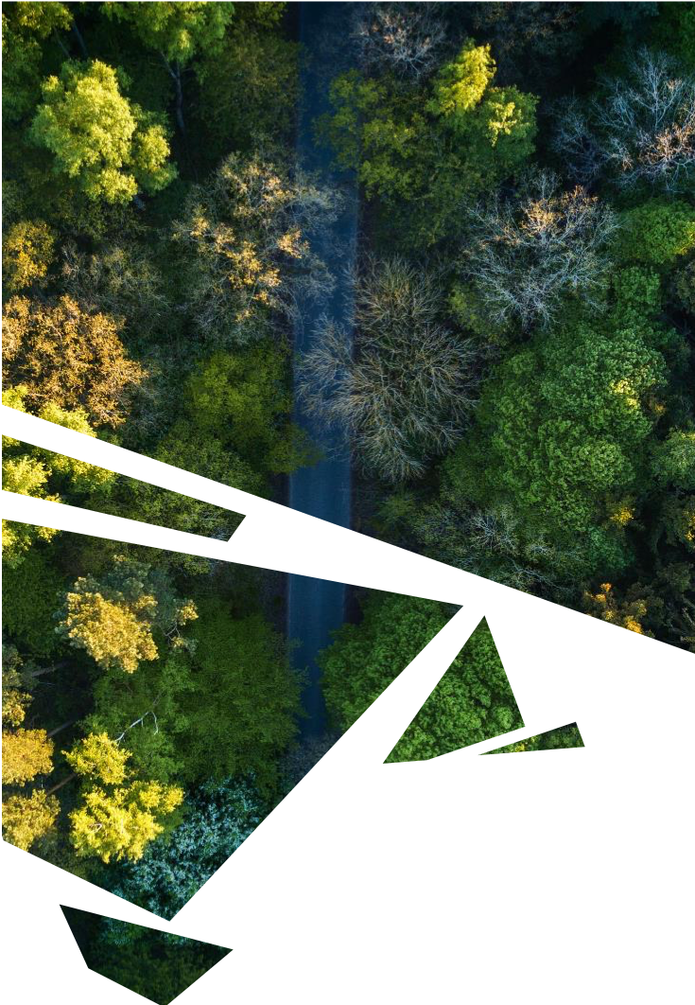
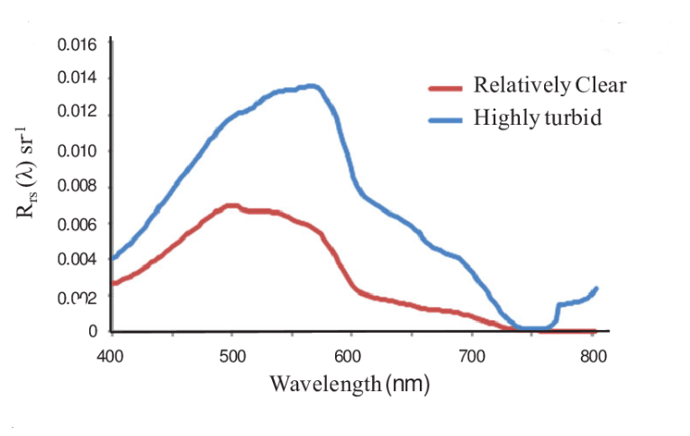
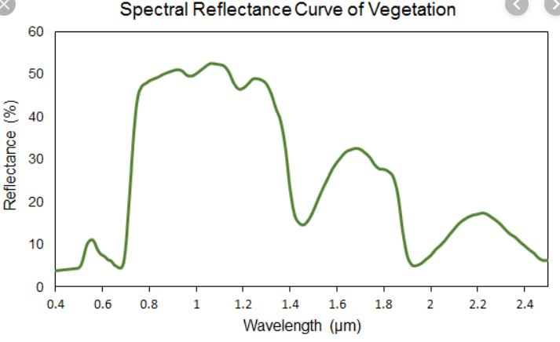
Approach – Indices for Water Quality Assessment
Spectral Reflectance Curve of Water
NDWI
NDCI
Chl-a
Leaf Moisture Content: (NIR - SWIR)/(NIR + SWIR)
Water Content: (Green - NIR)/(Green + NIR)
(Red Edge - Red)/ (Red Edge + Red)
Second order derivative of NDCI

Slide 6

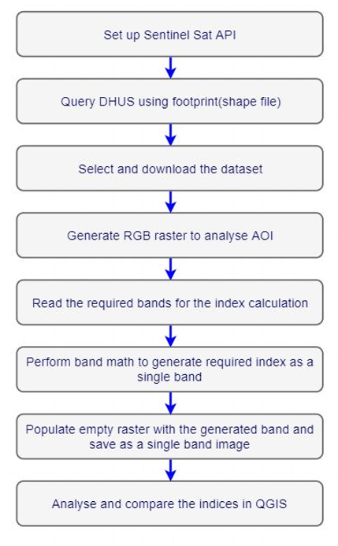
Methodology
Tools and Technologies:
Python 3.6.4
Anaconda 1.11.2
QGIS 3.8
Libraries:
gdal
sentinelsat
geopandas
rasterio
matplotlib

Slide 7
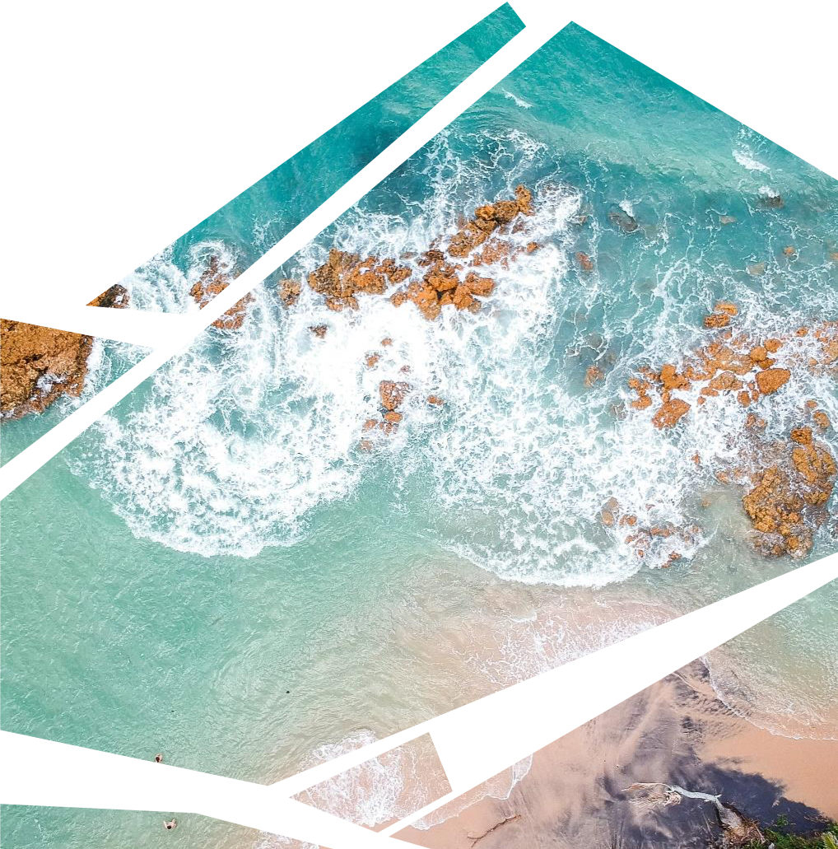



Results and Discussion
Digital Rasters of each Index
Generated using Python
Visualizing Water bodies in the image using QGIS
Locating water bodies in single band images
Contrasting Water Body with surrounding areas
Understanding the nature of indices

Slide 8
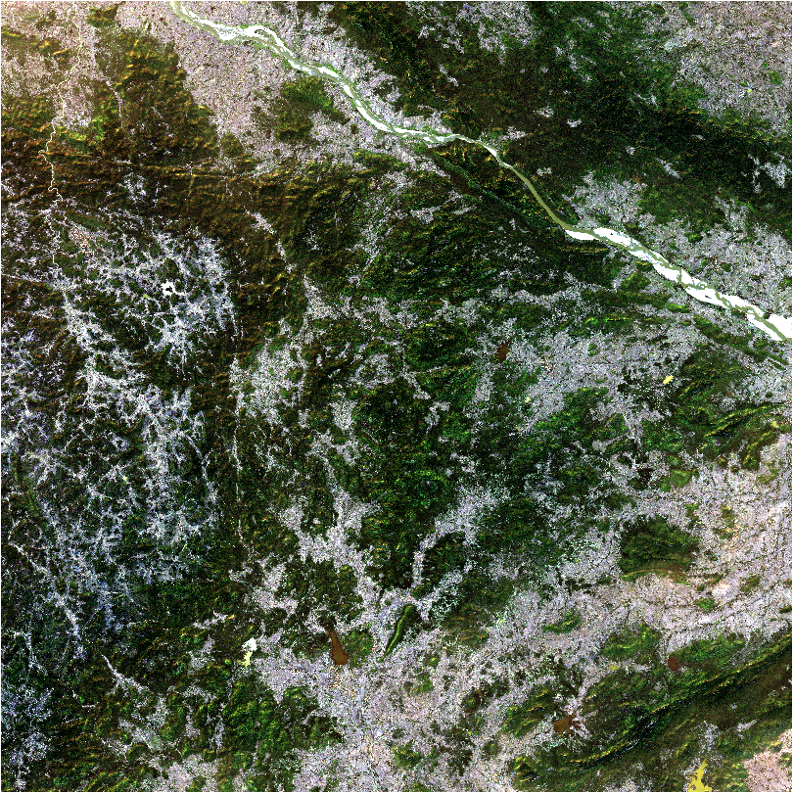
Digital Product
RGB Image Raster – Chilikha Lake
Bands – B2, B3, B4

Slide 9
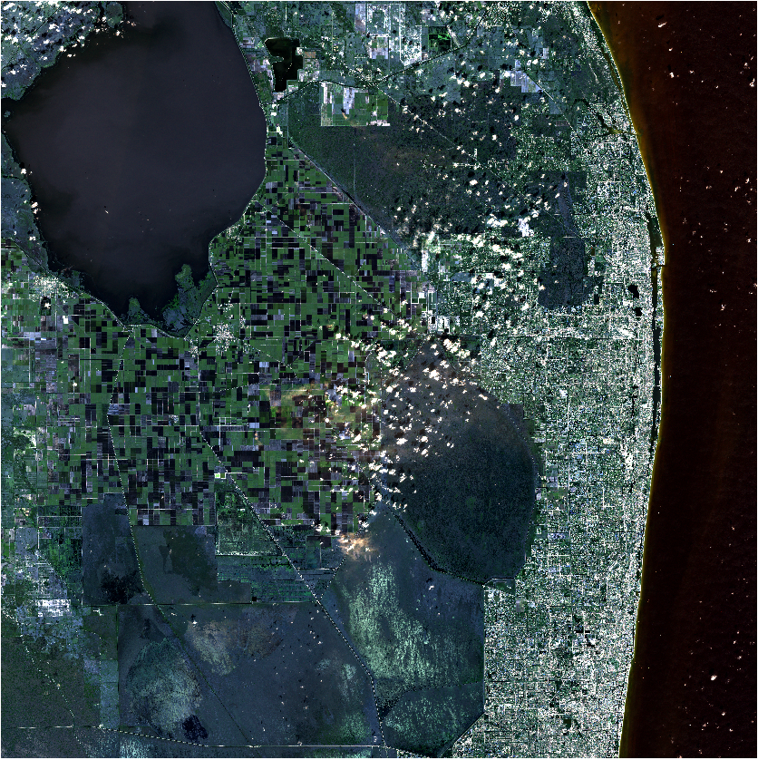
Digital Product
RGB Image Raster – Okeechobee Lake
Bands – B2, B3, B4

Slide 10
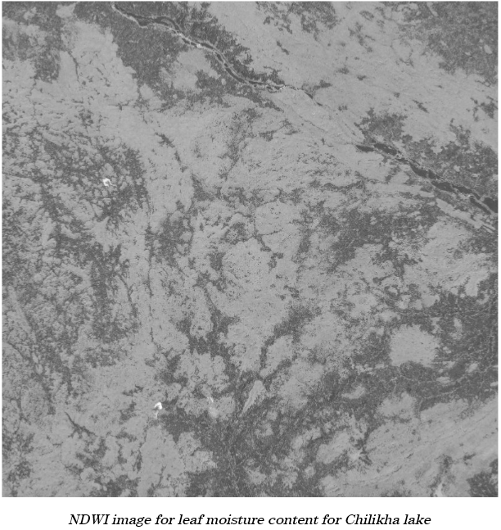
Digital Product
NDWI_lmc – Chilikha Lake
Bands – B8A, B11

Slide 11
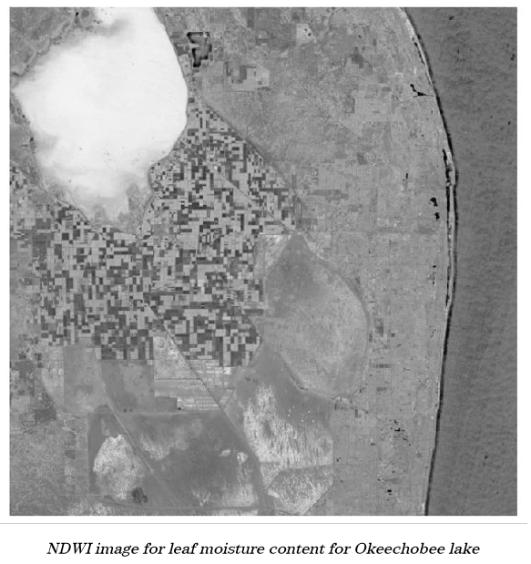
Digital Product
NDWI_lmc Image Raster – Okeechobee Lake
Bands – B8A, B11

Slide 12
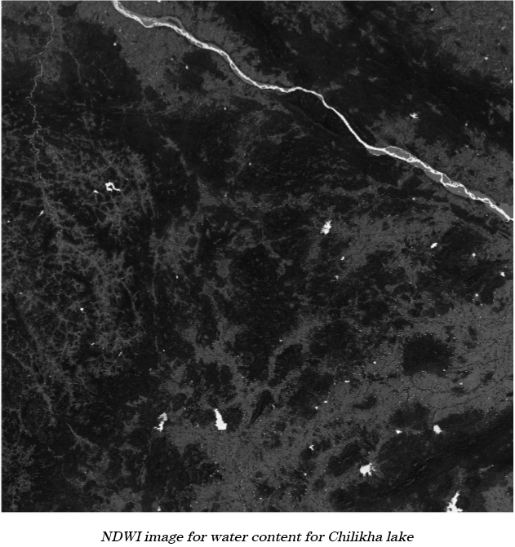
Digital Product
NDWI_wc Image Raster – Chilikha Lake
Bands – B3, B8

Slide 13
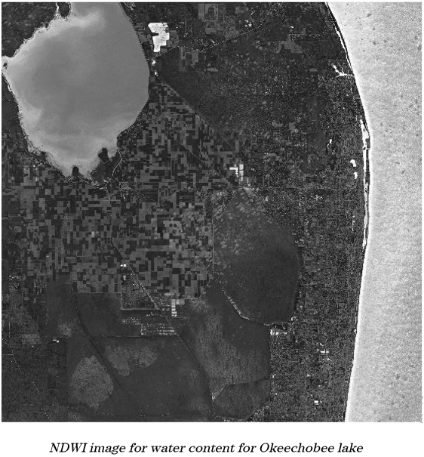
Digital Product
NDWI_wc Image Raster – Okeechobee Lake
Bands – B3, B8

Slide 14
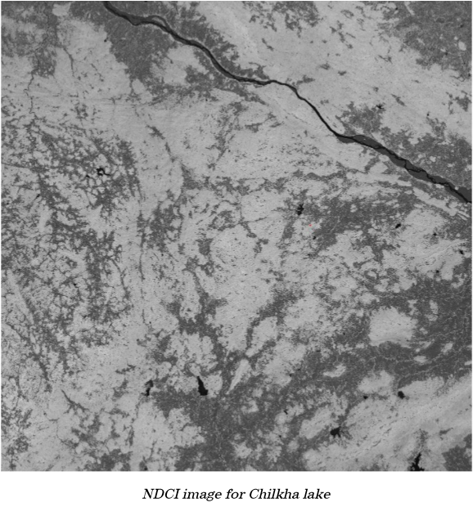
Digital Product
NDCI Image Raster – Chilikha Lake
Bands – B5, B4

Slide 15
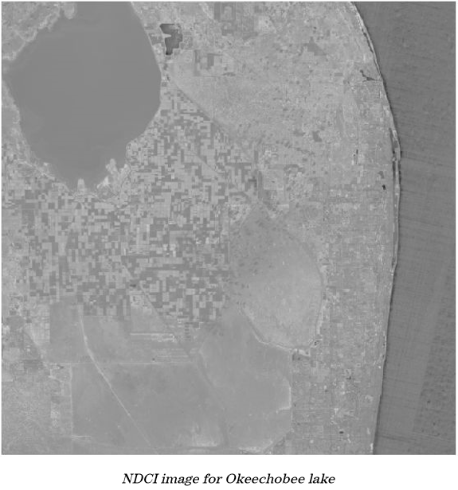
Digital Product
NDCI Image Raster – Okeechobee Lake
Bands – B5, B4

Slide 16
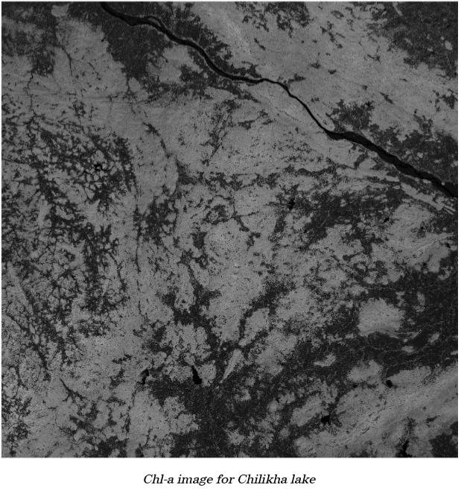
Digital Product
Chl-a Image Raster – Chilikha Lake
Bands – B4, B5 as a second order derivative of NDCI

Slide 17
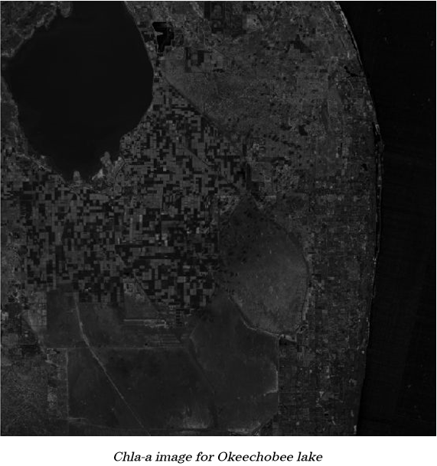
Digital Product
Chl-a Image Raster – Okeechobee Lake
Bands – B4, B5 as a second order derivative of NDCI

Slide 18

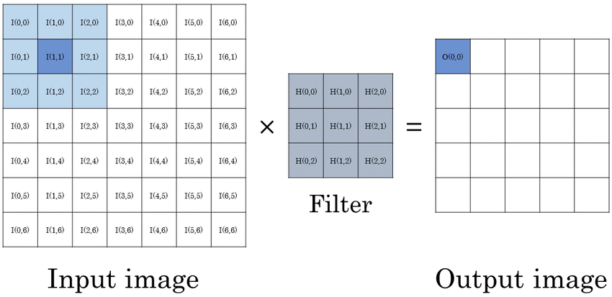
Future Scope
Developing kernels/filters of sizes 3x3, 5x5, 7x7 and 9x9 for all the indices
This will make index raster generation independent of the image source platform

Slide 19
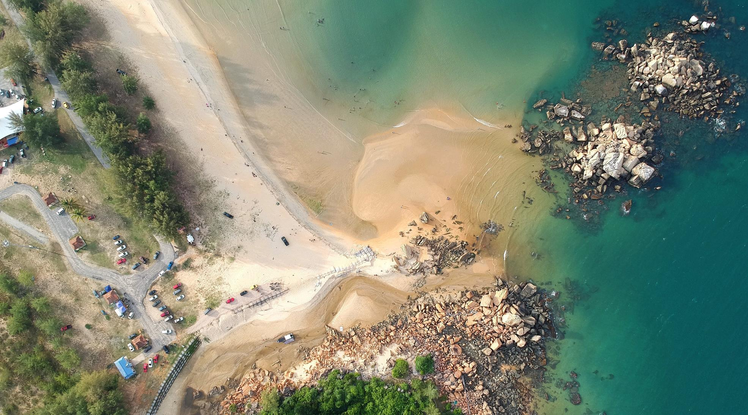

Thank You

